Slide 1
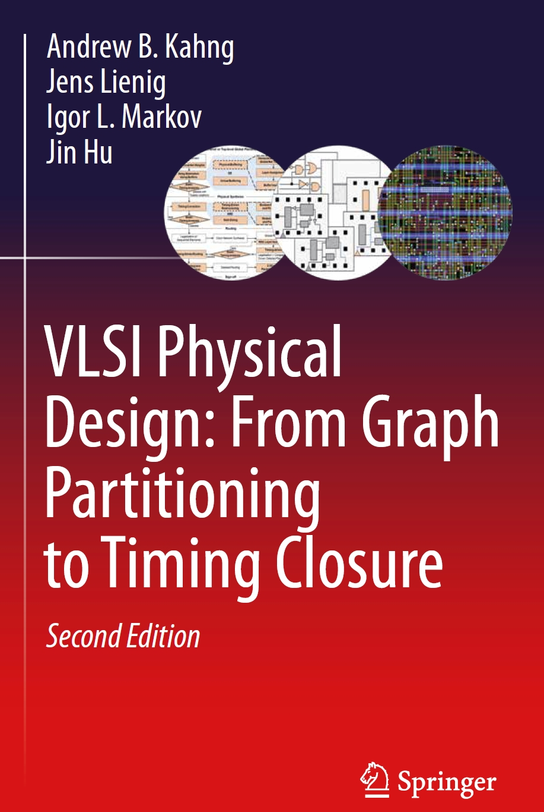
Chapter 5 – Global Routing

Slide 2
Chapter 5 – Global Routing
5.1 Introduction
5.2 Terminology and Definitions
5.3 Optimization Goals
5.4 Representations of Routing Regions
5.5 The Global Routing Flow
5.6 Single-Net Routing
    5.6.1 Rectilinear Routing
    5.6.2 Global Routing in a Connectivity Graph
    5.6.3 Finding Shortest Paths with Dijkstra’s Algorithm
    5.6.4 Finding Shortest Paths with A* Search
5.7 Full-Netlist Routing
    5.7.1 Routing by Integer Linear Programming
    5.7.2 Rip-Up and Reroute (RRR)
5.8 Modern Global Routing
    5.8.1 Pattern Routing
    5.8.2 Negotiated-Congestion Routing

Slide 3
5.1 Introduction
System Specification
Partitioning
Architectural Design
ENTITY test is
port a: in bit;
end ENTITY test;
Functional Design
and Logic Design
Chip Planning
Circuit Design
Placement
Physical Design
Clock Tree Synthesis
Physical Verification
and Signoff
DRC
LVS
ERC
Signal Routing
Fabrication
Timing Closure
Packaging and Testing
© 2022 Springer Verlag
Chip

Slide 4
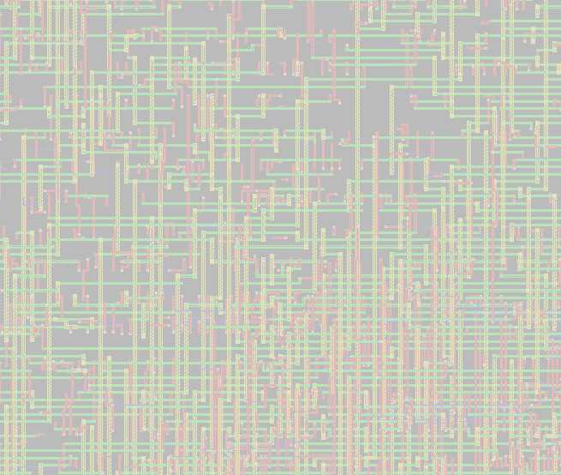
5.1 Introduction
Given a placement, a netlist and technology information,
determine the necessary wiring, e.g., net topologies and specific routing segments, to connect these cells
while respecting constraints, e.g., design rules and routing resource capacities, and
optimizing routing objectives, e.g., minimizing total wirelength and maximizing timing slack.

Slide 5
5.1 Introduction
Terminology:
Net: Set of two or more pins that have the same electric potential
Netlist: Set of all nets.
Congestion: Where the shortest routes of several nets are incompatible because they traverse the same tracks.
Fixed-die routing: Chip outline and routing resources are fixed.
Variable-die routing: New routing tracks can be added as needed.
5

Slide 6
5.1 Introduction: General Routing Problem
Netlist:
Placement result
N₁ = {C₄, D₆, B₃}
N₂ = {D₄, B₄, C₁, A₄}
N₃ = {C₂, D₅}
N₄ = {B₁, A₁, C₃}
3
4
C
1
A
1
2
4
Technology Information
(Design Rules)
1
3
B
4
5
6
4
D

Slide 7
5.1 Introduction: General Routing Problem
Netlist:
N₁ = {C₄, D₆, B₃}
N₂ = {D₄, B₄, C₁, A₄}
N₃ = {C₂, D₅}
N₄ = {B₁, A₁, C₃}
3
4
C
1
A
1
2
4
N₁
Technology Information
(Design Rules)
1
3
B
4
5
6
4
D

Slide 8
5.1 Introduction: General Routing Problem
Netlist:
N₁ = {C₄, D₆, B₃}
N₂ = {D₄, B₄, C₁, A₄}
N₃ = {C₂, D₅}
N₄ = {B₁, A₁, C₃}
3
4
C
1
A
1
2
N₄
4
N₂
N₃
N₁
Technology Information
(Design Rules)
1
3
B
4
5
6
4
D

Slide 9
5.1 Introduction
Routing
Multi-Stage Routing of Signal Nets
Global
Routing
Detailed
Routing
Timing-Driven Routing
Large Single- Net Routing
Geometric Techniques
Coarse-grain
assignment of
routes to
routing regions
(Chap. 5)
Fine-grain
assignment
of routes to
routing tracks
(Chap. 6)
Net topology
optimization
and resource
allocation to
critical nets
(Chap. 8)
Power (VDD)
and Ground
(GND)
routing
(Chap. 3)
Non-Manhattan
and
clock routing
(Chap. 7)

Slide 10
5.1 Introduction
Global Routing
Wire segments are tentatively assigned (embedded) within the chip layout
Chip area is represented by a coarse routing grid
Available routing resources are represented by edges with capacities
in a grid graph
Nets are assigned to these routing resources

Slide 11
5.1 Introduction
Global Routing
Detailed Routing
N₃
N₃
N₁
N₁
N₂
N₂
N₃
N₃
N₃
N₃
N₁
N₁
N₂
N₁
N₁
N₂
Horizontal
Segment
Vertical
Segment
Via

Slide 12

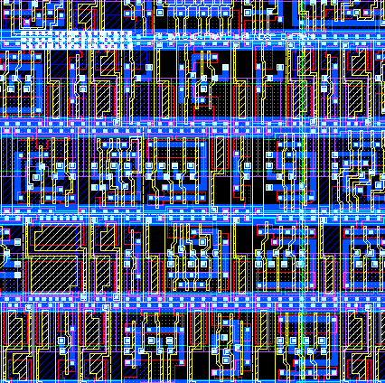
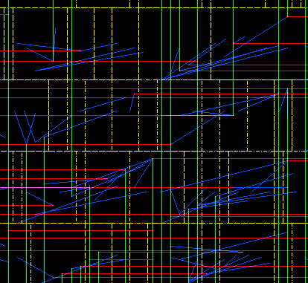
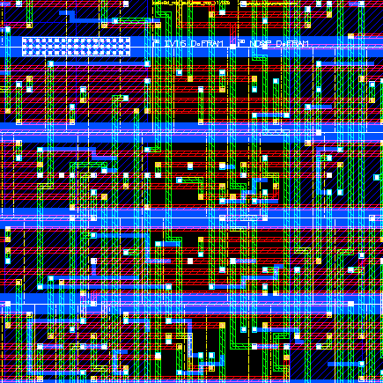
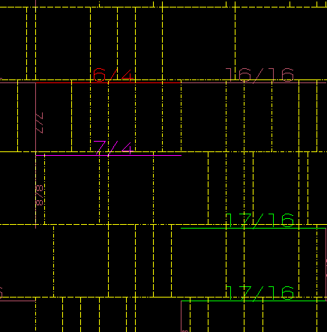
5.1.2 Globalverdrahtung
Wire Tracks
Placement
Global Routing
Detailed Routing
Congestion Map

Slide 13
5.2 Terminology and Definitions
Routing Track: Horizontal wiring path
Routing Column: Vertical wiring path
Routing Region: Region that contains routing tracks or columns
Uniform Routing Region: Evenly spaced horizontal/vertical grid
Non-uniform Routing Region: Horizontal and vertical boundaries that are aligned to external pin connections or macro-cell boundaries resulting in routing regions that have differing sizes
13

Slide 14
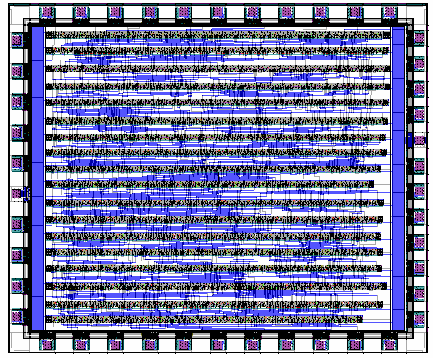
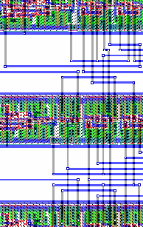
5.2 Terminology and Definitions
Channel
Rectangular routing region with pins on two opposite sides
Standard cell layout (Two-layer routing)

Slide 15
5.2 Terminology and Definitions
Channel
Rectangular routing region with pins on two opposite sides
Routing channel
Routing channel
Standard cell layout (Two-layer routing)

Slide 16
5.2 Terminology and Definitions
Capacity
Number of available routing tracks or columns
Horizontal Routing Channel
B
B
C
D
B
C
B
d_{pitch}
h
A
C
A
B
B
C
D

Slide 17
5.2 Terminology and Definitions
Capacity
Number of available routing tracks or columns
For single-layer routing, the capacity is the height h of the channel divided by the pitch d_{pitch}
For multilayer routing, the capacity σ is the sum of the capacities of all layers.
Horizontal Routing Channel
B
B
C
D
B
C
B
d_{pitch}
h
A
C
A
B
B
C
D

Slide 18
5.2 Terminology and Definitions
Switchbox (Two-layer macro cell layout)
Vertical
Channel
Intersection of horizontal and vertical channels
B
C
3
Horizontal
Channel
B
B
Horizontal
Channel
A
C
A
B
Vertical
Channel
Horizontal channel is routed after vertical channel is routed

Slide 19
5.2 Terminology and Definitions
T-junction (Two-layer macro cell layout)
B
C
C
B
B
Horizontal
Channel
A
C
A
B
Vertical
Channel

Slide 20
5.2 Terminology and Definitions
2D and 3D Switchboxes
Bottom pin connection
on 3D switchbox
Metal5
Metal4
3D switchbox
Top pin connection on cell
Pin on channel boundary
Horizontal
channel
2D switchbox
Metal3
Metal2
Metal1
Vertical channel

Slide 21
5.2 Terminology and Definitions
Gcells (Tiles) with macro cell layout
Metal1
Metal3
Metal2
Metal4
etc.

Slide 22
5.2 Terminology and Definitions
Gcells (Tiles) with standard cells
Metal1
(Standard cells)
Metal3
Metal2
(Cell ports)
Metal4
usw.

Slide 23
5.2 Terminology and Definitions
Gcells (Tiles) with standard cells (back-to-back)
Metal1
(Back-to-back-
standard cells)
Metal3
Metal2
(Cell ports)
Metal4
etc.

Slide 24
5.3 Optimization Goals
Global routing seeks to
  determine whether a given placement is routable, and
  determine a coarse routing for all nets within available routing regions
Considers goals such as
  minimizing total wirelength, and
  reducing signal delays on critical nets

Slide 25
5.3 Optimization Goals
Full-custom design
Layout is dominated by macro cells and routing regions are non-uniform
D
B
C
E
V
B
D
A
4
F
H
5
H
1
5
C
2
E
A
1
B
D
4
H
A
3
F
D
F
3
V
B
C
E
C
2
E
A
© 2022 Springer Verlag
F
(1) Types of channels
(2) Channel ordering

Slide 26
5.3 Optimization Goals
Standard-cell design
If number of metal layers is limited, feedthrough cells must be used to route across multiple cell rows
Feedthrough
cells
A
A
Variable-die,
standard cell design:
Total height =
ΣCell row heights +
All channel heights
A
A
A

Slide 27
5.3 Optimization Goals
Standard-cell design
Steiner tree solution with minimal wirelength
Steiner tree solution with
fewest feedthrough cells

Slide 28
5.3 Optimization Goals
Gate-array design
Cell sizes and sizes of routing regions between cells are fixed
Available
tracks
Key Tasks:
Determine routability
Find a feasible solution
Unrouted net

Slide 29
5.4 Representations of Routing Regions
5.1 Introduction
5.2 Terminology and Definitions
5.3 Optimization Goals
5.4 Representations of Routing Regions
5.5 The Global Routing Flow
5.6 Single-Net Routing
    5.6.1 Rectilinear Routing
    5.6.2 Global Routing in a Connectivity Graph
    5.6.3 Finding Shortest Paths with Dijkstra’s Algorithm
    5.6.4 Finding Shortest Paths with A* Search
5.7 Full-Netlist Routing
    5.7.1 Routing by Integer Linear Programming
    5.7.2 Rip-Up and Reroute (RRR)
5.8 Modern Global Routing
    5.8.1 Pattern Routing
    5.8.2 Negotiated-Congestion Routing

Slide 30
5.4 Representations of Routing Regions
Routing regions are represented using efficient data structures
Routing context is captured using a graph, where
  nodes represent routing regions and
  edges represent adjoining regions
Capacities are associated with both edges and nodes
to represent available routing resources

Slide 31
5.4 Representations of Routing Regions
Grid graph model
1
2
3
4
5
1
2
3
4
5
6
7
8
9
10
6
7
8
9
10
11
12
13
14
15
11
12
13
14
15
16
17
18
19
20
16
17
18
19
20
21
22
23
24
25
21
22
23
24
25
ggrid = (V,E), where the nodes v ∈ V represent the routing grid cells (gcells) and the edges represent connections of grid cell pairs (v_{i},v_{j})

Slide 32
5.4 Representations of Routing Regions
Channel connectivity graph
4
4
5
5
1
2
3
6
9
1
2
3
6
9
7
7
8
8
G = (V,E), where the nodes v ∈ V represent channels,
and the edges E represent adjacencies of the channels

Slide 33
5.4 Representations of Routing Regions
Switchbox connectivity graph
1
4
11
1
4
11
5
9
12
5
9
12
2
6
2
6
7
10
13
7
10
13
3
8
14
3
8
14
G = (V, E), where the nodes v ∈ V represent switchboxes
and an edge exists between two nodes if the corresponding switchboxes
are on opposite sides of the same channel

Slide 34
5.5 The Global Routing Flow – General Idea
Defining the routing regions (Region definition)
  Layout area is divided into routing regions
  Nets can also be routed over standard cells
  Regions, capacities and connections are represented by a graph
Mapping nets to the routing regions (Region assignment)
  Each net of the design is assigned to one or several
  routing regions to connect all of its pins
  Routing capacity, timing and congestion affect mapping
Assigning crosspoints along the edges of the routing regions (Midway routing)
  Routes are assigned to fixed locations or crosspoints
  along the edges of the routing regions
  Enables scaling of global and detailed routing

Slide 35
5.6 Single-Net Routing
5.1 Introduction
5.2 Terminology and Definitions
5.3 Optimization Goals
5.4 Representations of Routing Regions
5.5 The Global Routing Flow
5.6 Single-Net Routing
    5.6.1 Rectilinear Routing
    5.6.2 Global Routing in a Connectivity Graph
    5.6.3 Finding Shortest Paths with Dijkstra’s Algorithm
    5.6.4 Finding Shortest Paths with A* Search
5.7 Full-Netlist Routing
    5.7.1 Routing by Integer Linear Programming
    5.7.2 Rip-Up and Reroute (RRR)
5.8 Modern Global Routing
    5.8.1 Pattern Routing
    5.8.2 Negotiated-Congestion Routing

Slide 36
5.6.1 Rectilinear Routing
B (2, 6)
B (2, 6)
S (2, 4)
C (6, 4)
C (6, 4)
A (2, 1)
A (2, 1)
Rectilinear minimum spanning tree (RMST)
Rectilinear Steiner minimum tree (RSMT)

Slide 37
5.6.1 Rectilinear Routing
An RMST can be computed in O(p²) time, where p is the number of terminals
in the net using methods such as Prim’s Algorithm
Prim’s Algorithm builds an MST by starting with a single terminal and greedily adding least-cost edges to the partially-constructed tree
Advanced computational-geometric techniques reduce the runtime to O(p log p)
37

Slide 38
5.6.1 Rectilinear Routing
Characteristics of an RSMT
An RSMT for a p-pin net has between 0 and p – 2 (inclusive) Steiner points
The degree of any terminal pin is 1, 2, 3, or 4
The degree of a Steiner point is either 3 or 4
A RSMT is always enclosed in the minimum bounding box (MBB) of the net
The total edge length L_{RSMT} of the RSMT is at least half the perimeter
of the minimum bounding box of the net: L_{RSMT}  L_{MBB} / 2

Slide 39
5.6.1 Rectilinear Routing
Transforming an initial RMST into a low-cost RSMT
p₂
p₂
p₂
p₂
p₃
p₃
p₃
S
p₃
S₁
p₁
p₁
p₁
p₁
Construct L-shapes between points
with (most) overlap of net segments
Final tree (RSMT)
© 2022 Springer Verlag

Slide 40
5.6.1 Rectilinear Routing
Hanan grid
Adding Steiner points to an RMST can significantly reduce the wirelength
Maurice Hanan proved that for finding Steiner points, it suffices to consider only points located at the intersections of vertical and horizontal lines
that pass through terminal pins
The Hanan grid consists of the lines x = x_{p}, y = y_{p} that pass through the location (x_{p},y_{p}) of each terminal pin p
The Hanan grid contains at most (n²-n) candidate Steiner points
(n = number of pins), thereby greatly reducing the solution space
for finding an RSMT

Slide 41
5.6.1 Rectilinear Routing
Terminal pins
Intersection lines
Hanan points ( )
RSMT
© 2022 Springer Verlag

Slide 42
5.6.1 Rectilinear Routing
Definining routing regions
Pin connections
Pins assigned to grid cells

Slide 43
5.6.1 Rectilinear Routing
A
A
A
A
A
A
A
A
A
A
A
Pins assigned to grid cells
Rectilinear Steiner
minimum tree (RSMT)
Assigned routing regions
and feedthrough cells
Sequential Steiner Tree Heuristic

Slide 44
5.6.1 Rectilinear Routing
A Sequential Steiner Tree Heuristic
Find the closest (in terms of rectilinear distance) pin pair,
construct their minimum bounding box (MBB)
Find the closest point pair (p_{MBB},p_{C}) between any point p_{MBB} on the MBB
and p_{C} from the set of pins to consider
Construct the MBB of p_{MBB} and p_{C}
Add the L-shape that p_{MBB} lies on to T (deleting the other L-shape).
If p_{MBB} is a pin, then add any L-shape of the MBB to T.
Goto step 2 until the set of pins to consider is empty

Slide 45
5.6.1 Rectilinear Routing: Example Sequential Steiner Tree Heuristic
1

Slide 46
5.6.1 Rectilinear Routing: Example Sequential Steiner Tree Heuristic
1
2
1

Slide 47
5.6.1 Rectilinear Routing: Example Sequential Steiner Tree Heuristic
p_{c}
1
3
2
1
MBB

Slide 48
5.6.1 Rectilinear Routing: Example Sequential Steiner Tree Heuristic
1
3
1
3
2
1
2
2
4
p_{MBB}

Slide 49
5.6.1 Rectilinear Routing: Example Sequential Steiner Tree Heuristic
1
3
1
3
1
3
2
1
2
2
2
3
4
4
5

Slide 50
5.6.1 Rectilinear Routing: Example Sequential Steiner Tree Heuristic
1
3
1
3
1
3
2
1
2
2
2
3
4
4
5
1
3
2
4
4
6
5

Slide 51
5.6.1 Rectilinear Routing: Example Sequential Steiner Tree Heuristic
1
3
1
3
1
3
2
1
2
2
2
3
4
4
5
1
3
1
3
2
4
2
5
4
4
6
5
6
5
7

Slide 52
5.6.1 Rectilinear Routing: Example Sequential Steiner Tree Heuristic
1
3
1
3
1
3
2
1
2
2
2
3
4
4
5
1
3
1
3
1
3
2
4
2
5
2
6
4
4
4
6
5
6
5
6
5
© 2022 Springer Verlag
7
7

Slide 53
5.6.1 Rectilinear Routing: Example Sequential Steiner Tree Heuristic
1
3
1
3
1
3
2
1
2
2
2
3
4
4
5
1
3
1
3
1
3
2
4
2
5
2
6
4
4
4
6
5
6
5
6
5
© 2022 Springer Verlag
7
7

Slide 54
5.6.2 Global Routing in a Connectivity Graph
4
4
Channel
connectivity
graph
5
5
1
2
3
6
9
1
2
3
6
9
7
7
8
8
Switchbox
connectivity
graph
1
4
11
1
4
11
5
9
12
5
9
12
2
6
2
6
7
10
13
7
10
13
3
8
14
3
8
14

Slide 55
5.6.2 Global Routing in a Connectivity Graph
Channel
connectivity
graph
Switchbox
connectivity
graph

Slide 56
5.6.2 Global Routing in a Connectivity Graph
Combines switchboxes and channels, handles non-rectangular block shapes
Suitable for full-custom design and multi-chip modules
Overview:
1
2
3
4,2
4,2
4,2
4,2
3,1
4,2
1
A
2
3
B
4
1,2
1,5
1,2
1,2
7
1,2
0,4
0,1
1,2
4
5
6
7
5
6
A
8
4,2
4,2
9
4,2
4,2
8
B
9
10
11
12
2,2
2,7
2,2
2,2
2,7
2,2
10
11
12
Routing regions
Graph representation
Graph-based path search
© 2022 Springer Verlag

Slide 57
5.6.2 Global Routing in a Connectivity Graph
Defining the routing regions
+
Horizontal macro-cell edges
Vertical macro-cell edges

Slide 58
5.6.2 Global Routing in a Connectivity Graph
Defining the connectivity graph
1
8
17
21
23
1
8
17
21
23
2
9
18
2
9
18
3
10
3
24
19
24
10
19
4
11
12
4
11
12
5
13
14
15
20
22
25
5
13
14
15
20
22
25
6
26
6
26
7
16
27
16
27
7

Slide 59
5.6.2 Global Routing in a Connectivity Graph
Horizontal capacity
of routing region 1
Vertical capacity
of routing region 1
2 Tracks
1
1,2
8
17
21
23
1 Track
1
8
17
21
23
2
9
18
2
9
18
3
10
3
24
19
24
10
19
4
11
12
4
11
12
5
13
14
15
20
22
25
5
13
14
15
20
22
25
6
26
6
26
7
16
27
16
27
7

Slide 60
5.6.2 Global Routing in a Connectivity Graph
1
8
17
21
23
1,2
1,3
1,1
1,4
1,1
1
8
17
21
23
2
9
18
2,2
2,3
2,1
2
9
18
3
10
3
24
2,2
1,1
19
4,1
24
6,1
10
19
4
11
12
4
11
12
2,2
2,1
2,1
5
13
14
15
20
22
25
5
13
14
15
20
22
25
3,2
3,1
3,1
3,1
3,1
3,4
3,1
6
26
6
1,2
26
1,1
7
16
27
16
27
7
1,2
1,8
1,1

Slide 61
5.6.2 Global Routing in a Connectivity Graph
Algorithm Overview
Define routing regions
Define connectivity graph
Determine net ordering
Assign tracks for all pin connections in Netlist
Consider each net
  Free corresponding tracks for net’s pins
  Decompose net into two-pin subnets
  Find shortest path for subnet connectivity graph
  If no shortest path exists, do not route, otherwise, assign subnet to the nodes
  of shortest path and update routing capacities
If there are unrouted nets, goto Step 5, otherwise END

Slide 62
l
1
2
3
w
1
A
2
3
4,2
4,2
4,2
Example
Global routing
of the nets A-A and B-B
B
4
5
6
7
4
1,2
1,5
1,2
1,2
7
A
5
6
8
B
9
8
4,2
4,2
9
10
11
12
2,2
2,7
2,2
10
11
12

Slide 63
l
1
2
3
w
1
A
2
3
4,2
4,2
4,2
Example
Global routing
of the nets A-A and B-B
B
4
5
6
7
4
1,2
1,5
1,2
1,2
7
A
5
6
8
B
9
8
4,2
4,2
9
10
11
12
2,2
2,7
2,2
10
11
12
1
2
3
A
4,2
3,1
4,2
B
4
1,2
0,4
0,1
1,2
7
A
5
6
B
8
4,2
4,2
9
2,2
2,7
2,2
10
11
12

Slide 64
l
1
2
3
w
1
A
2
3
4,2
4,2
4,2
Example
Global routing
of the nets A-A and B-B
B
4
5
6
7
4
1,2
1,5
1,2
1,2
7
A
5
6
8
B
9
8
4,2
4,2
9
10
11
12
2,2
2,7
2,2
10
11
12
1
2
3
A
4,2
3,1
4,2
B
4
1,2
0,4
0,1
1,2
7
A
5
6
B
8
4,2
4,2
9
2,2
2,7
2,2
10
11
12
1
2
3
A
4,2
2,1
3,1
B
4
1,2
0,4
0,1
1,1
7
A
© 2022 Springer Verlag
B
5
6
8
3,1
4,1
9
1,1
1,7
1,1
10
11
12

Slide 65
l
w
1
A
2
3
Example
Global routing
of the nets A-A and B-B
B
4
5
6
7
A
8
B
9
10
11
12
A
B
A
B

Slide 66
1
2
3
Example
Determine routability
of a placement
1
2
3
3,1
3,4
3,3
B
A
5
6
7
4
5
6
7
4
1,4
1,1
1,4
1,3
B
8
9
A
10
3,4
3,1
3,3
8
9
10
1
2
3
3,1
3,4
3,3
1
2
3
B
A
5
6
7
4
5
6
7
4
0,3
0,1
0,4
0,2
B
8
9
A
10
3,4
3,1
2,2
8
9
10
1
2
3
3,1
3,4
3,3
?
1
2
3
5
6
7
B
A
4
0,3
0,1
0,4
0,2
4
5
6
7
B
8
9
A
10
3,4
3,1
2,2
8
9
10

Slide 67
1
2
3
Example
Determine routability
of a placement
1
2
3
3,1
3,4
3,3
B
A
5
6
7
4
5
6
7
4
1,4
1,1
1,4
1,3
B
8
9
A
10
3,4
3,1
3,3
8
9
10
1
2
3
3,1
3,4
3,3
1
2
3
B
A
5
6
7
4
5
6
7
4
0,3
0,1
0,4
0,2
B
8
9
A
10
3,4
3,1
2,2
8
9
10
1
2
3
2,0
2,3
3,3
1
2
3
5
6
7
B
A
4
0,2
0,0
0,3
0,2
4
5
6
7
B
8
9
A
10
2,3
2,0
2,2
8
9
10

Slide 68
Example
Determine routability
of a placement
1
2
3
B
A
4
5
6
7
B
8
9
A
10
1
2
3
B
A
4
5
6
7
B
8
9
A
10

Slide 69
5.6.3 Finding Shortest Paths with Dijkstra’s Algorithm
Finds a shortest path between two specific nodes in the routing graph
Input
  graph G(V,E) with non-negative edge weights W,
  source (starting) node s, and
  target (ending) node t
Maintains three groups of nodes
  Group 1 – contains the nodes that have not yet been visited
  Group 2 – contains the nodes that have been visited but for which the shortest-path cost from the starting node has not yet been found
  Group 3 – contains the nodes that have been visited and for which the shortest path cost from the starting node has been found
Once t is in Group 3, the algorithm finds the shortest path by backtracing

Slide 70
5.6.3 Finding Shortest Paths with Dijkstra’s Algorithm
Example
s
1,4
8,8
1
4
7
Find the shortest path from source s to target t where the path cost
∑w₁ + ∑w₂ is minimal
8,6
9,7
3,2
2
2,6
5
2,8
8
t
1,4
2,8
4,5
3
9,8
6
3,3
9

Slide 71
s
1
1,4
4
8,8
7
Group 2 | Group 3
8,6
9,7
3,2
(1)
2
2,6
5
2,8
8
t
1,4
2,8
4,5
3
9,8
6
3,3
9
Current node: 1

Slide 72
s
1
1,4
4
8,8
7
Group 2 | Group 3
N [2] 8,6
8,6
9,7
3,2
W [4] 1,4
[1]
2
2,6
5
2,8
8
t
W [4] 1,4
1,4
2,8
4,5
parent of node [node name] ∑w₁(s,node),∑w₂(s,node)
3
9,8
6
3,3
9
Current node: 1
Neighboring nodes: 2, 4
Minimum cost in group 2: node 4

Slide 73
s
1
1,4
4
8,8
7
Group 2 | Group 3
N [2] 8,6
8,6
9,7
3,2
W [4] 1,4
[1]
2
2,6
5
2,8
8
t
N [5] 10,11
W [7] 9,12
W [4] 1,4
1,4
2,8
4,5
N [2] 8,6
3
9,8
6
3,3
9
parent of node [node name] ∑w₁(s,node),∑w₂(s,node)
Current node: 4
Neighboring nodes: 1, 5, 7
Minimum cost in group 2: node 2

Slide 74
s
1
1,4
4
8,8
7
Group 2 | Group 3
N [2] 8,6
8,6
9,7
3,2
W [4] 1,4
[1]
2
2,6
5
2,8
8
t
N [5] 10,11
W [7] 9,12
W [4] 1,4
1,4
2,8
4,5
N [3] 9,10
W [5] 10,12
N [2] 8,6
3
9,8
6
3,3
9
N [3] 9,10
parent of node [node name] ∑w₁(s,node),∑w₂(s,node)
Current node: 2
Neighboring nodes: 1, 3, 5
Minimum cost in group 2: node 3

Slide 75
s
1
1,4
4
8,8
7
Group 2 | Group 3
N [2] 8,6
8,6
9,7
3,2
W [4] 1,4
[1]
2
2,6
5
2,8
8
t
N [5] 10,11
W [7] 9,12
W [4] 1,4
1,4
2,8
4,5
N [3] 9,10
W [5] 10,12
N [2] 8,6
3
9,8
6
3,3
9
W [6] 18,18
N [3] 9,10
Current node: 3
Neighboring nodes: 2, 6
N [5] 10,11
Minimum cost in group 2: node 5
parent of node [node name] ∑w₁(s,node),∑w₂(s,node)

Slide 76
s
1
1,4
4
8,8
7
Group 2 | Group 3
N [2] 8,6
8,6
9,7
3,2
W [4] 1,4
[1]
2
2,6
5
2,8
8
t
N [5] 10,11
W [7] 9,12
W [4] 1,4
1,4
2,8
4,5
N [3] 9,10
W [5] 10,12
N [2] 8,6
3
9,8
6
3,3
9
W [6] 18,18
N [3] 9,10
N [6] 12,19
Current node: 5
Neighboring nodes: 2, 4, 6, 8
N [5] 10,11
W [8] 12,19
Minimum cost in group 2: node 7
W [7] 9,12
parent of node [node name] ∑w₁(s,node),∑w₂(s,node)

Slide 77
s
1
1,4
4
8,8
7
Group 2 | Group 3
N (2) 8,6
8,6
9,7
3,2
W (4) 1,4
(1)
2
2,6
5
2,8
8
t
N (5) 10,11
W (7) 9,12
W (4) 1,4
1,4
2,8
4,5
N (3) 9,10
W (5) 10,12
N (2) 8,6
3
9,8
6
3,3
9
W (6) 18,18
N (3) 9,10
N (6) 12,19
Current node: 7
Neighboring nodes: 4, 8
N (5) 10,11
W (8) 12,19
Minimum cost in group 2: node 8
N (8) 12,14
W (7) 9,12
N (8) 12,14
parent of node [node name] ∑w₁(s,node),∑w₂(s,node)

Slide 78
s
1
1,4
4
8,8
7
Group 2 | Group 3
N (2) 8,6
8,6
9,7
3,2
W (4) 1,4
(1)
2
2,6
5
2,8
8
t
N (5) 10,11
W (7) 9,12
W (4) 1,4
1,4
2,8
4,5
N (3) 9,10
W (5) 10,12
N (2) 8,6
3
9,8
6
3,3
9
W (6) 18,18
N (3) 9,10
N (6) 12,19
Retrace from t to s
N (5) 10,11
W (8) 12,19
N (8) 12,14
W (7) 9,12
N (8) 12,14

Slide 79
s
1
1,4
4
9,12
7
12,14
2
5
8
t
3
6
9
Optimal path 1-4-7-8 from s to t with accumulated cost (12,14)

Slide 80
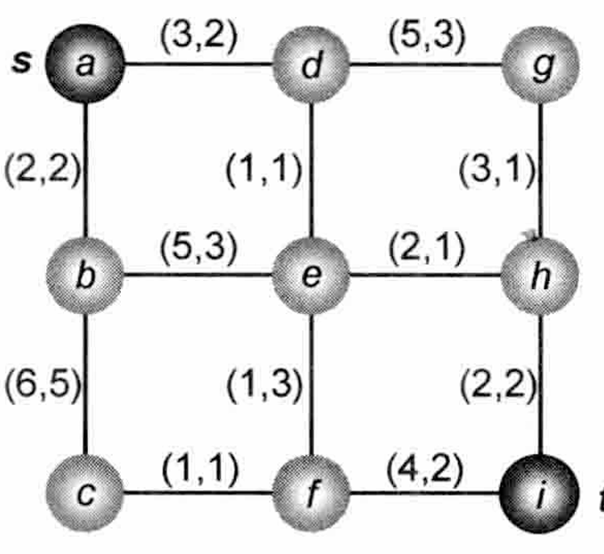

Slide 81
5.6.4 Finding Shortest Paths with A* Search
A* search operates similarly to Dijkstra’s algorithm, but extends the cost function to include an estimated distance from the current node to the target
Expands only the most promising nodes; its best-first search strategy eliminates a large portion of the solution space
30
21
29
19
28
t
22
13
O
11
20
t
5
4
O
O
6
1
5
12
O
3
1
s
Source
31
O
4
s
2
7
6
O
2
s
t
Target
27
18
10
3
8
14
26
17
9
15
23
O
Obstacle
25
16
24
Dijkstra‘s algorithm
(exploring 31 nodes)
A* search
(exploring 6 nodes)

Slide 82
5.6.4 Finding Shortest Paths with A* Search
Bidirectional A* search: nodes are expanded from both the source and target until the two expansion regions intersect
Number of nodes considered can be reduced
t
5
4
O
t
3
6
O
O
3
1
4
O
5
1
s
Source
O
2
s
O
2
s
t
Target
O
Obstacle
Unidirectional A* search
Bidirectional A* search

Slide 83
5.7 Full-Netlist Routing
5.1 Introduction
5.2 Terminology and Definitions
5.3 Optimization Goals
5.4 Representations of Routing Regions
5.5 The Global Routing Flow
5.6 Single-Net Routing
    5.6.1 Rectilinear Routing
    5.6.2 Global Routing in a Connectivity Graph
    5.6.3 Finding Shortest Paths with Dijkstra’s Algorithm
    5.6.4 Finding Shortest Paths with A* Search
5.7 Full-Netlist Routing
    5.7.1 Routing by Integer Linear Programming
    5.7.2 Rip-Up and Reroute (RRR)
5.8 Modern Global Routing
    5.8.1 Pattern Routing
    5.8.2 Negotiated-Congestion Routing

Slide 84
5.7 Full-Netlist Routing
Global routers must properly match nets with routing resources,
without oversubscribing resources in any part of the chip
Signal nets are either routed
  simultaneously, e.g., by integer linear programming, or
  sequentially, e.g., one net at a time
When certain nets cause resource contention or overflow for routing edges, sequential routing requires multiple iterations: rip-up and reroute

Slide 85
5.7.1 Routing by Integer Linear Programming
A linear program (LP) consists
  of a set of constraints and
  an optional objective function
Objective function is maximized or minimized
Both the constraints and the objective function must be linear
  Constraints form a system of linear equations and inequalities
Integer linear program (ILP): linear program
where every variable can only assume integer values
  Typically takes much longer to solve
  In many cases, variables are only allowed values 0 and 1
Several ways to formulate the global routing problem as an ILP,
one of which is presented next

Slide 86
5.7.1 Routing by Integer Linear Programming
Three inputs
  W × H routing grid G,
  Routing edge capacities, and
  Netlist
Two sets of variables
  k Boolean variables x_{net1}, x_{net2}, … , x_{netk}, each of which serves as an indicator
  for one of k specific paths or route options, for each net net  Netlist
  k real variables w_{net1}, w_{net2}, … , w_{netk}, each of which represents a net weight
  for a specific route option for net  Netlist
Two types of constraints
  Each net must select a single route (mutual exclusion)
  Number of routes assigned to each edge (total usage) cannot exceed its capacity

Slide 87
5.7.1 Routing by Integer Linear Programming
Inputs
  W,H: width W and height H of routing grid G
  G(i,j): grid cell at location (i,j) in routing grid G
  σ(G(i,j)~G(i + 1,j)): capacity of horizontal edge G(i,j) ~ G(i + 1,j)
  σ(G(i,j)~G(i,j + 1)): capacity of vertical edge G(i,j) ~ G(i,j + 1)
  Netlist: netlist
Variables
  x_{net1}, ... , x_{netk}: k Boolean path variables for each net net  Netlist
  w_{net1}, ... , w_{netk}: k net weights, one for each path of net net  Netlist
Maximize
Subject to
  Variable ranges
  Net constraints
  Capacity constraints

Slide 88
5.7.1 Routing by Integer Linear Programming – Example
Global Routing Using Integer Linear Programming
Given
  Nets A, B
  W = 5 × H = 4 routing grid G
  σ(e) = 1 for all e  G
  L-shapes have weight 1.00 and Z-shapes have weight 0.99
  The lower-left corner is (0,0).
Task
  Write the ILP to route the nets in the graph below
A
C
A
B
C
B

Slide 89
5.7.1 Routing by Integer Linear Programming – Example
Solution
  For net A, the possible routes are two L-shapes (A₁,A₂) and two Z-shapes (A₃,A₄)
  For net B, the possible routes are two L-shapes (B₁,B₂) and one Z-shape (B₃)
  For net C, the possible routes are two L-shapes (C₁,C₂) and two Z-shapes (C₃,C₄)
A
A₁
A
A₃
Net Constraints:
x_{A1} + x_{A2} + x_{A3} + x_{A4} ≤ 1
Variable Constraints:
0 ≤ x_{A1} ≤ 1, 0 ≤ x_{A2} ≤ 1,
0 ≤ x_{A3} ≤ 1, 0 ≤ x_{A4} ≤ 1
A₂
A₄
A
A
Net Constraints:
x_{B1} + x_{B2} + x_{B3} ≤ 1
Variable Constraints:
0 ≤ x_{B1} ≤ 1, 0 ≤ x_{B2} ≤ 1,
0 ≤ x_{B3} ≤ 1
B₂
B₁
B
B₃
B
B
B
C₃
Net Constraints:
x_{C1} + x_{C2}+ x_{C3} + x_{C4} ≤ 1
Variable Constraints:
0 ≤ x_{C1} ≤ 1, 0 ≤ x_{C2} ≤ 1,
0 ≤ x_{C3} ≤ 1, 0 ≤ x_{C4} ≤ 1
C₂
C
C
C₁
C₄
C
C

Slide 90
5.7.1 Routing by Integer Linear Programming – Example
Horizontal Edge Capacity Constraints:
G(0,0) ~ G(1,0): x_{C1} + x_{C3} ≤ σ(G(0,0) ~ G(1,0)) = 1
G(1,0) ~ G(2,0): x_{C1} ≤ σ(G(1,0) ~ G(2,0)) = 1
G(2,0) ~ G(3,0): x_{B1} + x_{B3} ≤ σ(G(2,0) ~ G(3,0)) = 1
G(3,0) ~ G(4,0): x_{B1} ≤ σ(G(3,0) ~ G(4,0)) = 1
G(0,1) ~ G(1,1): x_{A2} + x_{C4} ≤ σ(G(0,1) ~ G(1,1)) = 1
G(1,1) ~ G(2,1): x_{A2} + x_{A3} + x_{C4} ≤ σ(G(1,1) ~ G(2,1)) = 1
G(2,1) ~ G(3,1): x_{B2} ≤ σ(G(2,1) ~ G(3,1)) = 1
G(3,1) ~ G(4,1): x_{B2} + x_{B3} ≤ σ(G(3,1) ~ G(4,1)) = 1
G(0,2) ~ G(1,2): x_{A4} + x_{C2} ≤ σ(G(0,2) ~ G(1,2)) = 1
G(1,2) ~ G(2,2): x_{A4} + x_{C2} + x_{C3} ≤ σ(G(1,2) ~ G(2,2)) = 1
G(0,3) ~ G(1,3): x_{A1} + x_{A3} ≤ σ(G(0,3) ~ G(1,3)) = 1
G(1,3) ~ G(2,3): x_{A1} ≤ σ(G(1,3) ~ G(2,3)) = 1
Vertical Edge Capacity Constraints:
G(0,0) ~ G(0,1): x_{C2} + x_{C4} ≤ σ(G(0,0) ~ G(0,1)) = 1
G(1,0) ~ G(1,1): x_{C3} ≤ σ(G(1,0) ~ G(1,1)) = 1
G(2,0) ~ G(2,1): x_{B2} + x_{C1} ≤ σ(G(2,0) ~ G(2,1)) = 1
G(3,0) ~ G(3,1): x_{B3} ≤ σ(G(3,0) ~ G(3,1)) = 1
G(4,0) ~ G(4,1): x_{B1} ≤ σ(G(4,0) ~ G(4,1)) = 1
G(0,1) ~ G(0,2): x_{A2} + x_{C2} ≤ σ(G(0,1) ~ G(0,2)) = 1
G(1,1) ~ G(1,2): x_{A3} + x_{C3} ≤ σ(G(1,1) ~ G(1,2)) = 1
G(2,1) ~ G(2,2): x_{A1} + x_{A4} + x_{C1} + x_{C4} ≤ σ(G(2,1) ~ G(2,2)) = 1
G(0,2) ~ G(0,3): x_{A2} + x_{A4} ≤ σ(G(0,2) ~ G(0,3)) = 1
G(1,2) ~ G(1,3): x_{A3} ≤ σ(G(1,2) ~ G(1,3)) = 1
G(2,2) ~ G(2,3): x_{A1} ≤ σ(G(2,2) ~ G(2,3)) = 1

Slide 91
5.7.2 Rip-Up and Reroute (RRR)
Rip-up and reroute (RRR) framework: focuses on hard-to-route nets
Idea: allow temporary violations, so that all nets are routed, but then iteratively remove some nets (rip-up), and route them differently (reroute)
B
A’
D’
Routing without
allowing violations
A
Routing with allowing violations and RRR
B’
D
C
C’
B
A’
B
A’
D’
D’
A
A
B’
B’
D
C
D
C
C’
C’
WL = 21
WL = 19

Slide 92
5.8 Modern Global Routing
5.1 Introduction
5.2 Terminology and Definitions
5.3 Optimization Goals
5.4 Representations of Routing Regions
5.5 The Global Routing Flow
5.6 Single-Net Routing
    5.6.1 Rectilinear Routing
    5.6.2 Global Routing in a Connectivity Graph
    5.6.3 Finding Shortest Paths with Dijkstra’s Algorithm
    5.6.4 Finding Shortest Paths with A* Search
5.7 Full-Netlist Routing
    5.7.1 Routing by Integer Linear Programming
    5.7.2 Rip-Up and Reroute (RRR)
5.8 Modern Global Routing
    5.8.1 Pattern Routing
    5.8.2 Negotiated-Congestion Routing

Slide 93
5.8 Modern Global Routing
General flow for modern global routers, where each router uses a unique set of optimizations:
Global Routing Instance
Net Decomposition
Initial Routing
no
Violations?
Layer Assignment
(optional)
yes
Final Improvements
Rip-up and Reroute

Slide 94
5.8 Modern Global Routing
Pattern Routing
  Searches through a small number of route patterns to improve runtime
  Topologies commonly used in pattern routing: L-shapes, Z-shapes, U-shapes
Up-Right
L-Shape
Right-Up
L-Shape
Up-Right-Up
Z-Shape
Right-Up-Right
Z-Shape
Detour-Up
Vertical
U-Shape
Detour-
Down
Vertical
U-Shape
Detour-
Left
Horizontal
U-Shape
Detour-
Right
Horizontal
U-Shape

Slide 95
5.8 Modern Global Routing
Negotiated-Congestion Routing
  Each edge e is assigned a cost value cost(e) that reflects the demand for edge e
  A segment from net net that is routed through e pays a cost of cost(e)
  Total cost of net is the sum of cost(e) values taken over all edges used by net:
  The edge cost cost(e) is increased according to the edge congestion φ(e), defined as the total number of nets passing through e divided by the capacity of e:
  A higher cost(e) value discourages nets from using e and implicitly encourages nets to seek out other, less used edges
  Iterative routing approaches (Dijkstra’s algorithm, A* search, etc.) find routes
  with minimum cost while respecting edge capacities

Slide 96
Summary of Chapter 5 – Types of Routing
Global Routing
Input: netlist, placement, obstacles + (usually) routing grid
Partitions the routing region (chip or block) into global routing cells (gcells)
Considers the locations of cells within a region as identical
Plans routes as sequences of gcells
Minimizes total length of routes and, possibly, routed congestion
May fail if routing resources are insufficient
  Variable-die can expand the routing area, so can't usually fail
  Fixed-die is more common today (cannot resize a block in a larger chip)
Interpreting failures in global routing
  Failure with many violations => must restructure the netlist
  and/or redo global placement
  Failure with few violations => detailed routing may be able to fix the problems

Slide 97
Summary of Chapter 5 – Types of Routing
Detailed Routing
Input: netlist, placement, obstacles, global routes (on a routing grid),
routing tracks, design rules
Seeks to implement each global route as a sequence of track segments
Includes layer assignment (unless that is performed during global routing)
Minimizes total length of routes, subject to design rules
Timing-Driven routing
Minimizes circuit delay by optimizing timing-critical nets
Usually needs to trade off route length and congestion against timing
Both global and detailed routing can be timing-driven

Slide 98
Summary of Chapter 5 – Types of Routing
Large-Net Routing
Nets with many pins can be so complex that routing a single net
warrants dedicated algorithms
Steiner tree construction
  Minimum wirelength, extensions for obstacle-avoidance
  Nonuniform routing costs to model congestion
Large signal nets are routed as part of global routing
and then split into smaller segments processed during detailed routing
Clock Tree Routing / Power Routing
Performed before global routing to avoid competition for resources
occupied by signal nets

Slide 99
Summary of Chapter 5 – Routing Single Nets
Usually ~50% of the nets are two-pin nets, ~25% have three pins,
~12.5% have four, etc.
  Two-pin nets can be routed as L-shapes or using maze search
  (in a connectivity graph of the routing regions)
  Three-pin nets usually have 0 or 1 branching point
  Larger nets are more difficult to handle
Pattern routing
  For each net, considers only a small number of shapes (L, Z, U, T, E)
  Very fast, but misses many opportunities
  Good for initial routing, sometimes is sufficient
Routing pin-to-pin connections
  Breadth-first-search (when costs are uniform)
  Dijkstra's algorithm (non-uniform costs)
  A*-search (non-uniform costs and/or using additional distance information)

Slide 100
Summary of Chapter 5 – Routing Single Nets
Minimum Spanning Trees and Steiner Minimal Trees in the rectilinear topology (RMSTs and RSMTs)
  RMSTs can be constructed in near-linear time
  Constructing RSMTs is NP-hard, but feasible in practice
Each edge of an RMST or RSMT can be considered a pin-to-pin connection
and routed accordingly
Routing congestion introduces non-uniform costs, complicates the construction of minimal trees (which is why A*-search still must be used)
For nets with <10 pins, RSMTs can be found using look-up tables (FLUTE)
very quickly

Slide 101
Summary of Chapter 5 – Full Netlist Routing
Routing by Integer Linear Programming (ILP)
  Capture the route of each net by 0-1 variables, form equations
  constraining those variables
  The objective function can represent total route length
  Solve the equations while minimizing the objective function (ILP software)
  Usually a convenient but slow technique, may not scale to largest netlists
  (can be extended by area partitioning)
Rip-up and Re-route (RRR)
  Processes one net at a time, usually by A*-search and Steiner-tree heuristics
  Allows temporary overlaps between nets
  When every net is routed (with overlaps), it removes (rips up) those with overlaps and routes them again with penalty for overlaps
  This process may not finish, but often does, else use a time-out
Both ILP-based routing and RRR can be applied in global and detailed routing
  ILP-based routing is usually preferable for small, difficult-to-route regions
  RRR is much faster when routing is easy

Slide 102
Summary of Chapter 5 – Modern Global Routing
Initial routes are constructed quickly by pattern routing and the FLUTE package for Steiner tree construction - very fast
Several iterations based on modified pattern routing to avoid congestion
- also very fast
  Sometimes completes all routes without violations
  If violations remain, they are limited to a few congested spots
The main part of the router is based on a variant of RRR
called Negotiated-Congestion Routing (NCR)
  Several proposed alternatives are not competitive
NCR maintains "history" in terms of which regions attracted too many nets
NCR increases routing cost according to the historical popularity of the regions
  The nets with alternative routes are forced to take those routes
  The nets that do not have good alternatives remain unchanged
  Speed of increase controls tradeoff between runtime and route quality

